Slide 1

Analysis of data scientist salaries
Insights for competitive compensation
Christopher Rodgers
April 13, 2024

Slide 2
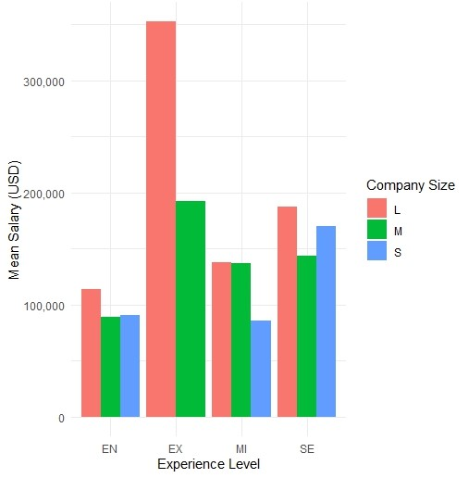
Introduction
Mean Salary for Full-Time Data Scientist by Experience Level and Company Size
EN- Entry-Level/Junior
MI- Mid-Level/Intermediate
SE- Senior Level/Expert
EX- Executive-Level/Director
S(Small)- Less than 50 Employees
M (Medium) – 50 to 250 Employees
L(Large)- More than 250 Employees
Notes:
Here, we showcase bar plots displaying the mean salary of full-time data scientists across various experience levels and company sizes. This visualization clearly depicts how salaries differ among different experience levels (Entry-level, Mid-level, Senior-level) and company sizes (Small, Medium, large) within our organization. We can identify any notable patterns or discrepancies that may impact our compensation approach by analyzing these distributions.

Slide 3

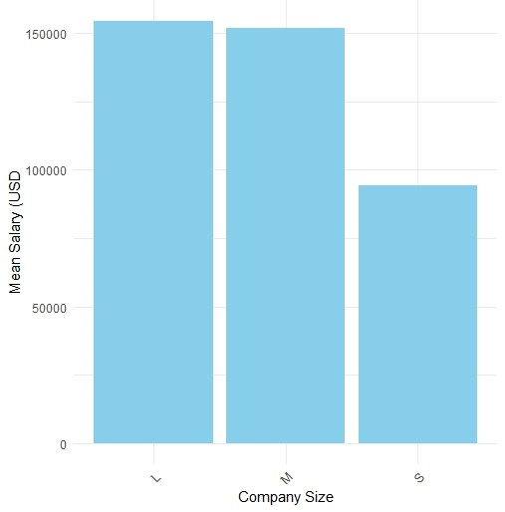
Current Salary Distribution
Notes:
We visualize the distribution of current salaries for full-time data scientists based in the United States, focusing specifically on those working in small companies. The plot provides a clear picture of the mean wages within our target market. Understanding the current distribution is essential for assessing our competitiveness and setting appropriate salary ranges to attract top talent.

Slide 4

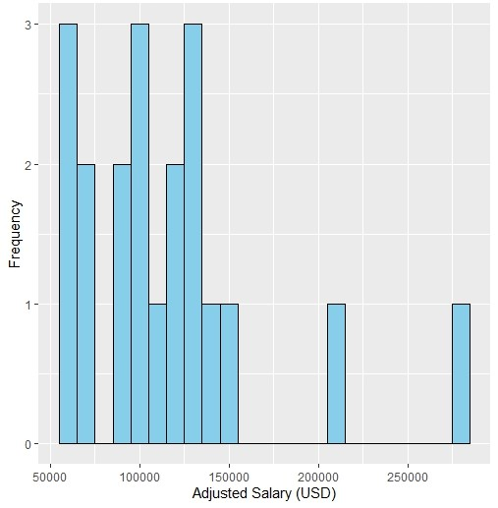
Adjusted Salary Range (10% increase)
Notes:
The plot displays the distribution of salaries after applying a 10% increase to accommodate the competitive market and the company's rapid expansion. By visualizing the adjusted salary range, we can assess the impact of the proposed salary adjustment on salary distribution. This analysis helps us determine whether the adjusted salary range aligns with our goal of attracting and retaining top talent in a highly competitive market.

Slide 5
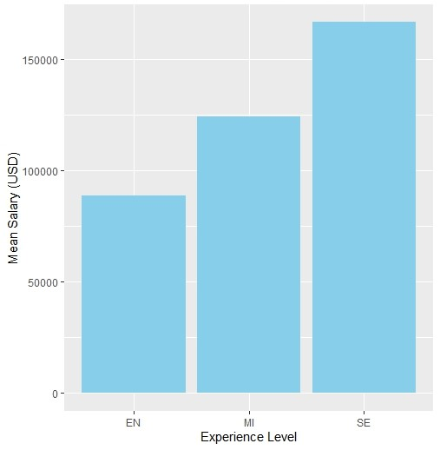
Mean Salary of Full-time data scientist by experience level
Notes:
This bar plot showcases the mean salary of full-time data scientists categorized by experience level. By comparing salary levels across different experience levels, we can identify any trends or patterns in compensation within the data science field. Understanding these variations in salary based on experience level is essential for designing salary structures that incentivize career growth and attract experienced professionals to our organization.

Slide 6

Thank You
Salary Recommendation
Position: Data Scientist
Experience Level: Senior
Salary Range: $180,000 - $190,000
Ideal Candidate
Robust and Diverse Range of Experience
Experience leading and executing end-to-end projects
Drives business impact through data-driven insights
Experience working in a dynamic and fast-paced environment
Adaptability, problem-solving, and ability to collaborate effectively
Possess technical expertise and demonstrates a passion for learning, innovation, and driving positive change
Notes:
Based on the mean salary of $175,000 for a senior-level data scientist in a small company, I recommend providing a competitive salary range that reflects market trends and ensures we can attract top talent. Considering the highly competitive market and our company's rapid expansion, I suggest offering a salary range with a lower bound slightly above the mean, perhaps around $180,000 to $190,000. This range demonstrates our commitment to offering competitive compensation while providing room for negotiation and flexibility.
For a senior-level data scientist position, we highly value and appreciate candidates with a robust and diverse range of experience. Specifically, we recognize individuals who have demonstrated expertise in advanced statistical analysis, machine learning algorithms, and data visualization techniques. Additionally, candidates should possess a strong background in programming languages commonly used in data science, such as Python, R, or SQL.
Experience leading and executing end-to-end data science projects would be precious, from problem formulation and data collection to model development and deployment. Moreover, candidates who successfully drive business impact through data-driven insights and recommendations would be preferred.
In our rapidly expanding company with evolving needs, we empower and value candidates who have experience working in dynamic and fast-paced environments. Adaptability, problem-solving skills, and the ability to collaborate effectively with cross-functional teams are not just essential attributes, but are integral to success in our organization.
Overall, I prioritize candidates who possess technical expertise and demonstrate a passion for continuous learning, innovation, and driving positive change through data-driven decision-making.

